Slide 1

Development of a knowledge base of Ti-alloys from first-principles and computational thermodynamics
Cassie Marker
Department of Materials Science and Engineering
Advisor: Dr. Zi-Kui Liu
4/11/17

Slide 2
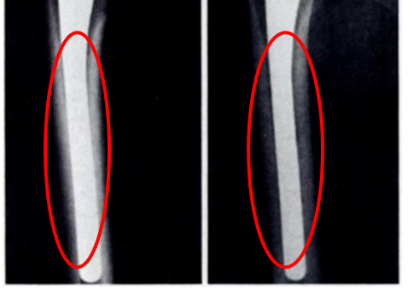
Background: Ti-alloys Biomedical Applications
Ti-Mo-Nb-Ta-Sn-Zr system
Elastic properties
Thermodynamics and phase stability
Alloy | Young’s Modulus (GPa)
Bone | 10-40
Cp-Ti | 105
Ti-6Al-4V | 110
Stainless Steel | 200
CoCrMo | 200-230
A
B
M. Long, H.J. Rack, Biomaterials. 19 (1998) 1621–1639.
Engh C., Bobyn J., Glassman A., Journal of Bone & Joint Surgery, 69 (1987) 45-55.
Notes:
2010 1,061,000 total knee and hip replacements, double by 2020, 14% of hip and 10% of knee replacements were revision surgeries. Focus on biocompatibility fatigue strength, corrosion and young’s modulus

Slide 3
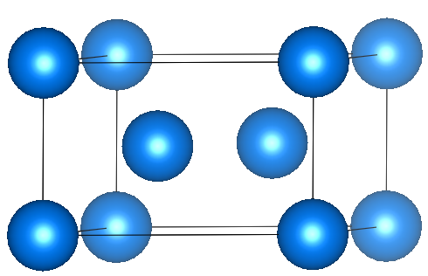
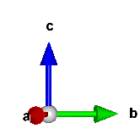
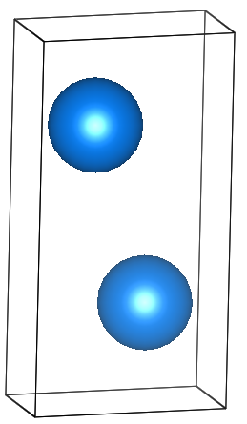
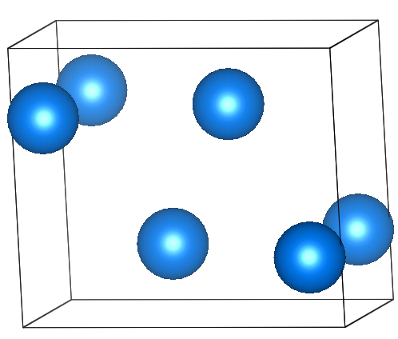
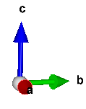
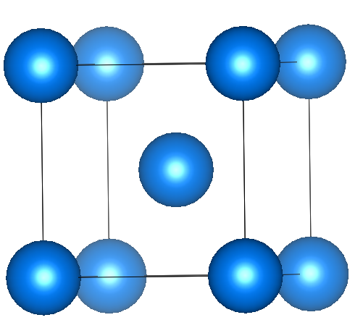
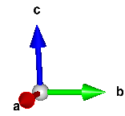
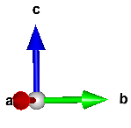
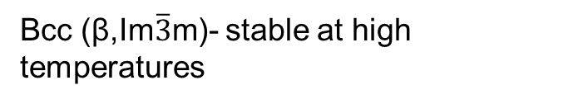
Phase Stabilities
ω (P6/mmm)- hexagonal metastable phase
Hcp (α,P6₃/mmc) Standard element reference state of Ti. Stable at room temperature
Alloy | Phase | Young’s Modulus
Ti | α | 105
Ti-6Al-4V | α+β | 110
Ti-35Nb-5Ta-7Zr | β | 55
Ti-13Nb-13Zr | α“+β | 79
Ti-25Nb-Ta-Zr | α+ω | 88
α“(Cmcm)-orthorhombic martensitic transformation-displacive
Bcc (β,Im$\overline{3}$m)- stable at high temperatures
A. Jain*, S.P. Ong*, G. Hautier, W. Chen, W.D. Richards, S. Dacek, S. Cholia, D. Gunter, D. Skinner, G. Ceder, K.A. Persson APL Materials, 2013, 1(1), 011002.
M. Long, H.J. Rack, Biomaterials. 19 (1998) 1621–1639.

Slide 4
Objectives
Study equilibrium phase stability
Establish a thermodynamic and elastic database for the Ti-Mo-Nb-Sn-Ta-Zr system
Study metastable phase stability
Study the elastic properties, phase stability and transformation of α” and ω phases

Slide 5
Objectives
Study equilibrium phase stability
Establish a thermodynamic and elastic database for the Ti-Mo-Nb-Sn-Ta-Zr system
Study metastable phase stability
Study the elastic properties, phase stability and transformation of α” and ω phases

Slide 6
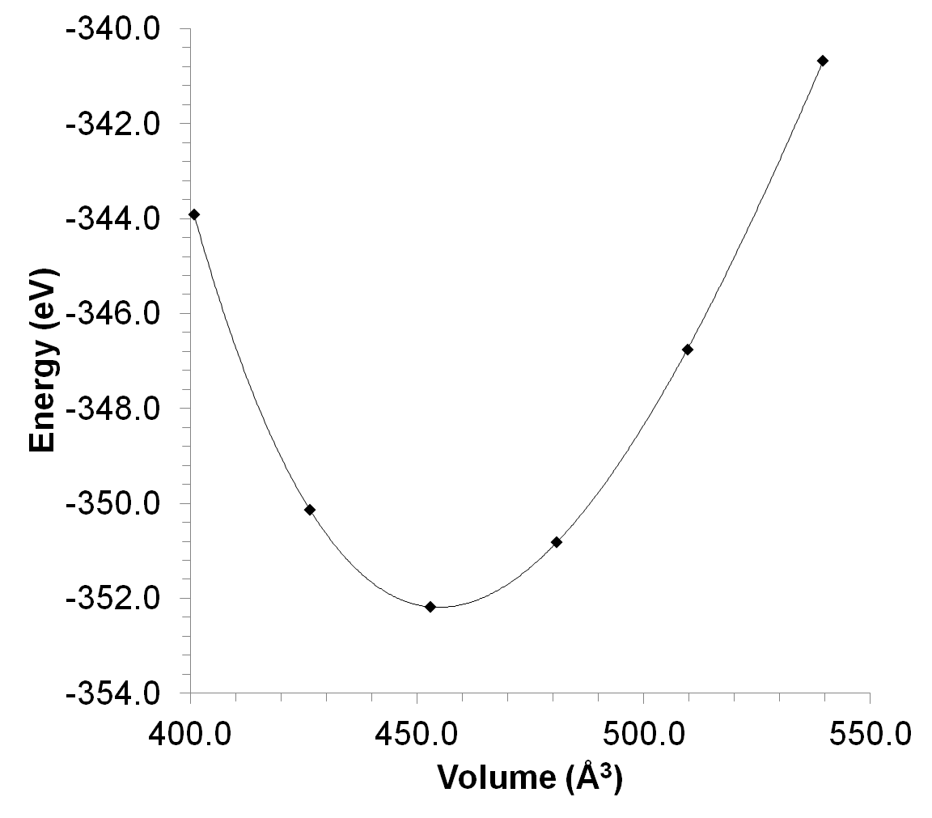
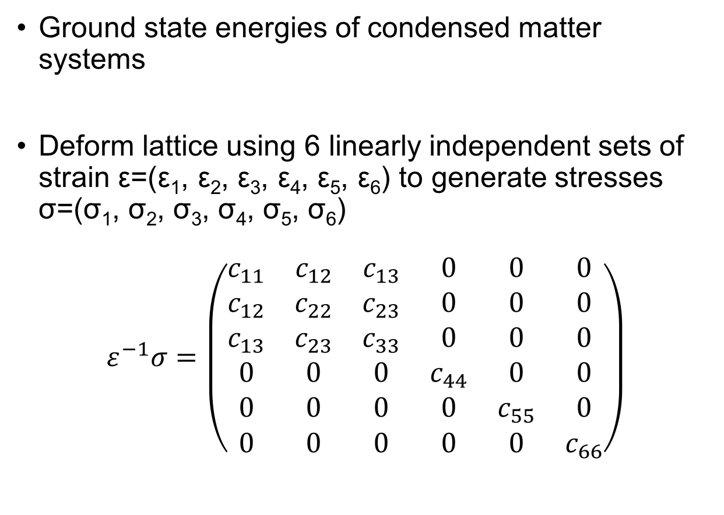
First-Principles based on DFT 0 K
E_{0K} EOS fitting: static ground state energy of the crystal
Ground state energies of condensed matter systems
Deform lattice using 6 linearly independent sets of strain ε=(ε₁, ε₂, ε₃, ε₄, ε₅, ε₆) to generate stresses σ=(σ₁, σ₂, σ₃, σ₄, σ₅, σ₆)
$$ε^{−1}σ=\left(\begin{matrix}c_{11} & c_{12} & c_{13} & 0 & 0 & 0 \\ c_{12} & c_{22} & c_{23} & 0 & 0 & 0 \\ c_{13} & c_{23} & c_{33} & 0 & 0 & 0 \\ 0 & 0 & 0 & c_{44} & 0 & 0 \\ 0 & 0 & 0 & 0 & c_{55} & 0 \\ 0 & 0 & 0 & 0 & 0 & c_{66}\end{matrix}\right)$$
S.L. Shang et al., Comput. Mater. Sci. 47 (2010) 1040–1048.; Y. Wang et al., Acta Mater. 52 (2004) 2665–2671.; A. Wang et al., Calphad. 37 (2012) 126–131.
Notes:
where E₀ is the static contribution at 0 K without the contribution of zero-point vibrational energy, F_{Vib} the temperature-dependent vibrational contribution, and F_{T-el} the thermal electronic contribution. At ambient pressure, the Helmholtz energy of the system is equal to the Gibbs energy, which is used in the CALPHAD modeling F_{T-el} based on electronic density of states and calculated with Fermi-Dirac statistics E_{el}-Ts_{el}

Slide 7
First-Principles based on DFT finite temperature
$$F\left(V,T\right)=E_{0K}\left(V\right)+F_{vib}\left(V,T\right)+F_{T−el}\left(V,T\right)$$
Temperature-dependent crystal vibrations, obtained from the Debye-Grüneisen model or phonon supercell approach
F_{Vib}(V,T)
F_{T-el}(V,T)
Temperature-dependent thermal-electronic excitation contributions to the free energy
S.L. Shang et al., Comput. Mater. Sci. 47 (2010) 1040–1048.; Y. Wang et al., Acta Mater. 52 (2004) 2665–2671.; A. Wang et al., Calphad. 37 (2012) 126–131.
Notes:
where E₀ is the static contribution at 0 K without the contribution of zero-point vibrational energy, F_{Vib} the temperature-dependent vibrational contribution, and F_{T-el} the thermal electronic contribution. At ambient pressure, the Helmholtz energy of the system is equal to the Gibbs energy, which is used in the CALPHAD modeling F_{T-el} based on electronic density of states and calculated with Fermi-Dirac statistics E_{el}-Ts_{el}

Slide 8

CALculations of PHAse Diagrams (CALPHAD)
Fewer data points supplemented by first-principles calculations
Experimental data plenty, hard to predict using first-principles
Thermochemical data: enthalpy entropy, heat capacity, activity …
Phase equilibria data: liquidus, solidus, phase boundary/composition
Gibbs energy (parameterized)
Practical applications: T, P, ni
Phase diagrams, direct applications
http://www.calphad.org
$$G_{m}^{∅}=x_{i}{}_{}^{0}{G_{i}^{∅}+x_{j}{}_{}^{0}{G_{j}^{∅}+RT\left[x_{i}\ln\left(x_{i}\right)+x_{j}\ln\left(x_{j}\right)\right]+{}_{}^{XS}{G_{m}^{∅}}}}$$
Z.-K. Liu, J. Phase Equilibria Diffus. 30 (2009) 517–534.; Z.-K. Liu, H. Zhang, S. Ganeshan, Y. Wang, S.N. Mathaudhu, Scr. Mater. 63 (2010) 686–691.

Slide 9
Ti-Mo-Nb-(Sn)-Ta-Zr Database Objectives
Pure elements → Binary → Ternary → Multi-component
Ti-Mo
Ti-Nb
Ti-Sn
Ti-Ta
Ti-Zr
Mo-Nb
Mo-Sn
Mo-Ta
Nb-Sn
Nb-Ta
Nb-Zr
Sn-Ta
Sn-Zr
Ta-Zr
Mo-Zr
Ti-Mo-Nb
Ti-Mo-Ta
Ti-Mo-Zr
Ti-Nb-Ta
Ti-Nb-Zr
Ti-Ta-Zr
Literature
New
Future

Slide 10
Thermodynamic Modeling- Pure Elements
Pure Elements |  | V0 (A/atom) | E0 (eV/atom) | B (GPa) | B’
hcp-Ti | This work | 17.37 | -7.80 | 113 | 3.54
 | Expt [1] |  |  | 110
Bcc-Mo | This work | 15.91 | -10.84 | 262 | 4.37
 | Expt [2] |  |  | 261
Bcc-Nb | This work | 18.14 | -10.22 | 171 | 3.78
 | Expt [3] |  |  | 172
Bcc-Ta | This work | 18.32 | -11.85 | 196 | 4.32
 | Expt [3] |  |  | 196
hcp-Zr | This work | 23.44 | -8.51 | 94 | 3.13
 | Expt [4-6] |  |  | 94
[1] I. Wolfram Research, Matematica, (n.d.). [2] J.M. Dickinson, P.E. Armstrong, J. Appl. Phys. 38 (1967) 602–606.; [3] D.I. Bolef, J. Appl. Phys. 32 (1961) 100–105. [4] R.M. Treco, Trans. Am. Inst. Mining, Metall. Pet. Eng. 197 (1953) 344–348.; [5] G. Bergerhoff, R. Hundt, R. Sievers, I.D. Brown, J. Chem. Inf. Comput. Sci. 23 (1983); [6] F.I.Z. Karlsruhe, Inorganic Crystal Structure Database, (n.d.).

Slide 11
Thermodynamic Modeling-Binary Systems
T. Uesugi, S. Miyamae, K. Higashi, Mater. Trans. 54 (2013) 484–492.

Slide 12
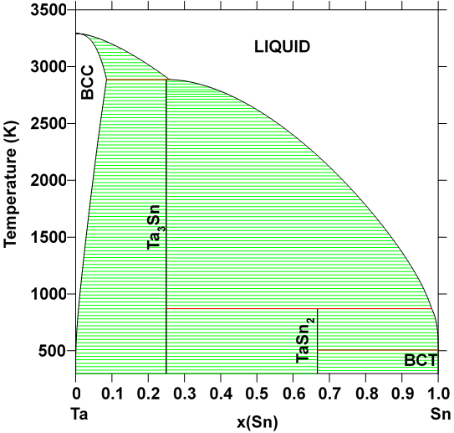
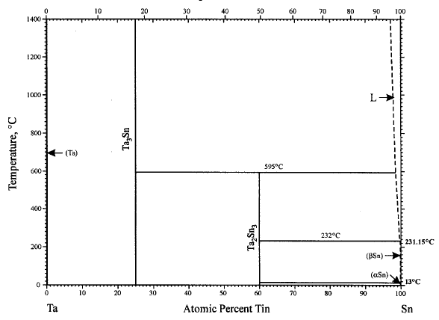
Ta-Sn Thermodynamic Modeling
Observed Phases: bct Sn, diamond Sn, bcc, Ta₃Sn, TaSn₂
H. Okamoto, Sn-Ta (Tin-Tantalum), J. Phase Equilibria. 24 (2003) 484.

Slide 13
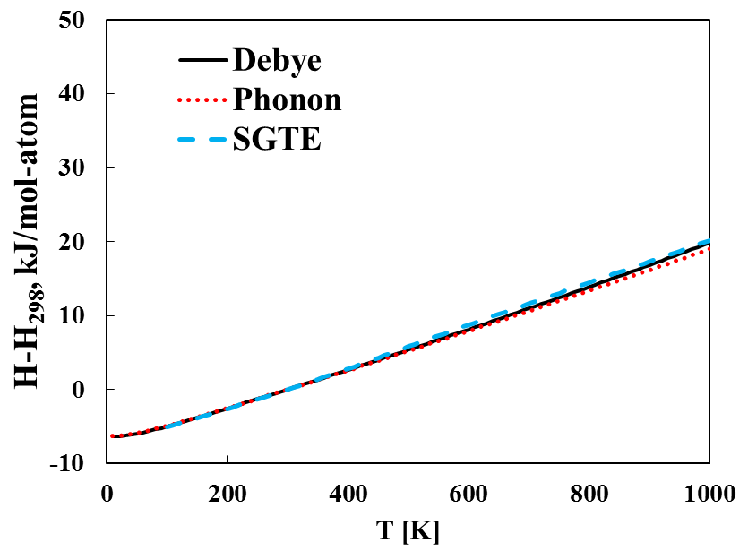
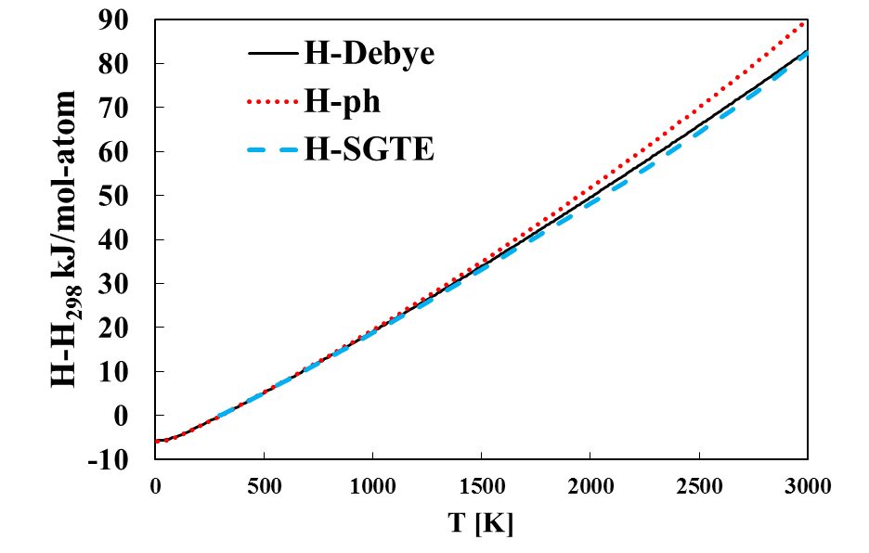
Calculated the pure elements
Bcc Ta
Bct Sn
A.T. Dinsdale, CALPHAD. 15 (1991) 317–425.

Slide 14
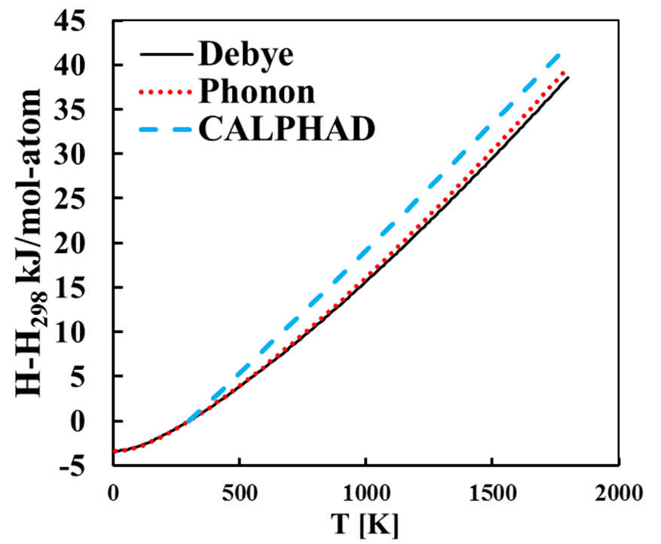
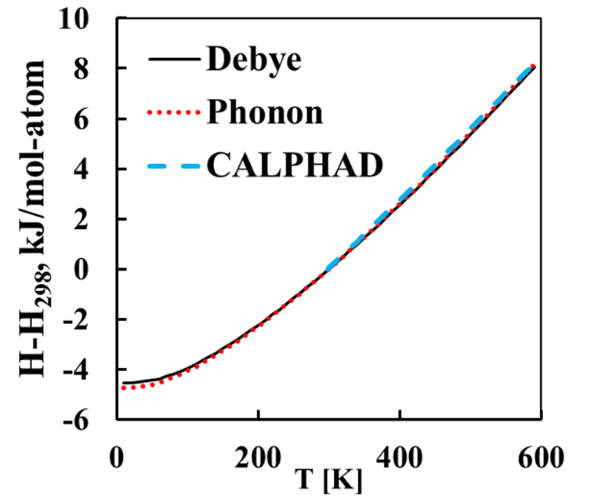
Calculated the Stoichiometric compounds
Ta₃Sn
TaSn₂

Slide 15
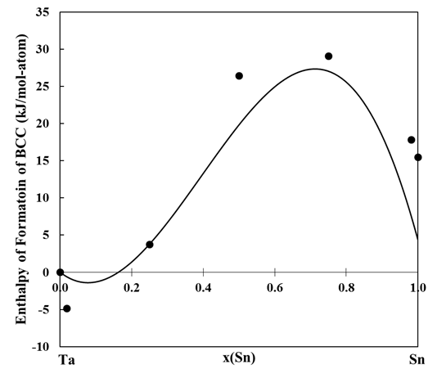
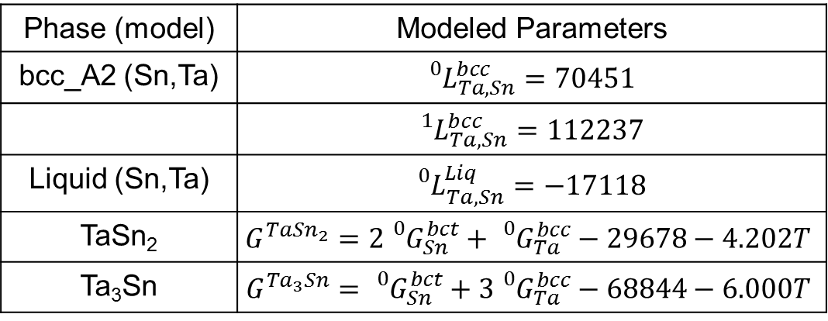
Enthalpy of Formation and Modeled Parameters
Phase (model) | Modeled Parameters
bcc_A2 (Sn,Ta) | $${}_{}^{0}{L_{Ta,Sn}^{bcc}=70451}$$
 | $${}_{}^{1}{L_{Ta,Sn}^{bcc}=112237}$$
Liquid (Sn,Ta) | $${}_{}^{0}{L_{Ta,Sn}^{Liq}=−17118}$$
TaSn₂ | $$G^{Ta{Sn}_{2}}=2{}_{}^{0}{G_{Sn}^{bct}+{}_{}^{0}{G_{Ta}^{bcc}}−29678−4.202T}$$
Ta₃Sn | $$G^{{Ta}_{3}Sn}={}_{}^{0}{G_{Sn}^{bct}+3{}_{}^{0}{G_{Ta}^{bcc}}−68844−6.000T}$$

Slide 16
Thermodynamic Modeling-Ti-X-Y
o-phase boundary
•-single-phase
◑-two-phase
673 K
823 K
Phase | Parameters | Value
BCC_A2 (Nb,Ta,Ti) |  | -136603
 |  | -136602
673 K
823 K
L. Na, W.H. Warnes, Ieee Trans. Appl. Supercond. 11 (2001) 3800–3803.

Slide 17
Elastic Modeling- Pure Elements
Pure Elements |  | C₁₁ (GPa) | C₁₂ (GPa) | C₄₄ (GPa) | B (GPa)
Bcc-Ti | This work | 93 | 115 | 41 | 107
 | FP [1] | 96 | 116 | 40 | 107
Bcc-Mo | This work | 475 | 164 | 108 | 268
 | Expt [2] | 473 | 160 | 109 | 261
Bcc-Nb | This work | 245 | 144 | 27 | 178
 | Expt [3] | 247 | 135 | 29 | 172
Bcc-Ta | This work | 278 | 164 | 81 | 202
 | Expt [3] | 267 | 161 | 83 | 196
Bcc-Sn | This work | 50 | 52 | 29 | 52
 | FP [1] | 30 | 60 | 18 | 48
Bcc-Zr | This work | 86 | 91 | 32 | 89
 | FP [1] | 82 | 94 | 30 | 90
[1] S.L. Shang et al., Comput. Mater. Sci. 48 (2010) 813–826.; [2] J.M. Dickinson et al., J. Appl. Phys. 38 (1967) 602–606.; [3] D.I. Bolef, Appl. Phys. 32 (1961) 100–105.

Slide 18
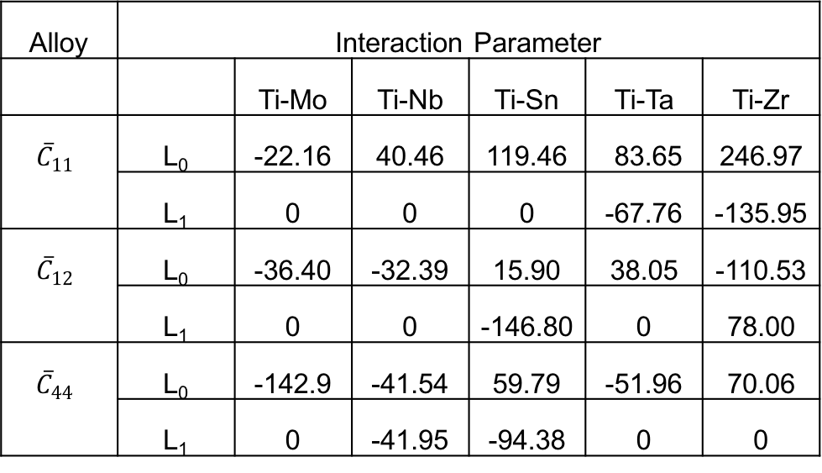
Elastic Modeling- Ti-X C_{ij}
Alloy | Interaction Parameter
 |  | Ti-Mo | Ti-Nb | Ti-Sn | Ti-Ta | Ti-Zr
$${\overline{C}}_{11}$$ | L₀ | -22.16 | 40.46 | 119.46 | 83.65 | 246.97
 | L₁ | 0 | 0 | 0 | -67.76 | -135.95
$${\overline{C}}_{12}$$ | L₀ | -36.40 | -32.39 | 15.90 | 38.05 | -110.53
 | L₁ | 0 | 0 | -146.80 | 0 | 78.00
${\overline{C}}_{44}$ | L₀ | -142.9 | -41.54 | 59.79 | -51.96 | 70.06
 | L₁ | 0 | -41.95 | -94.38 | 0 | 0
H. Ikehata, N. Nagasako, T. Furuta, A. Fukumoto, K. Miwa, T. Saito, Phys. Rev. B. 70 (2004) 174113.

Slide 19
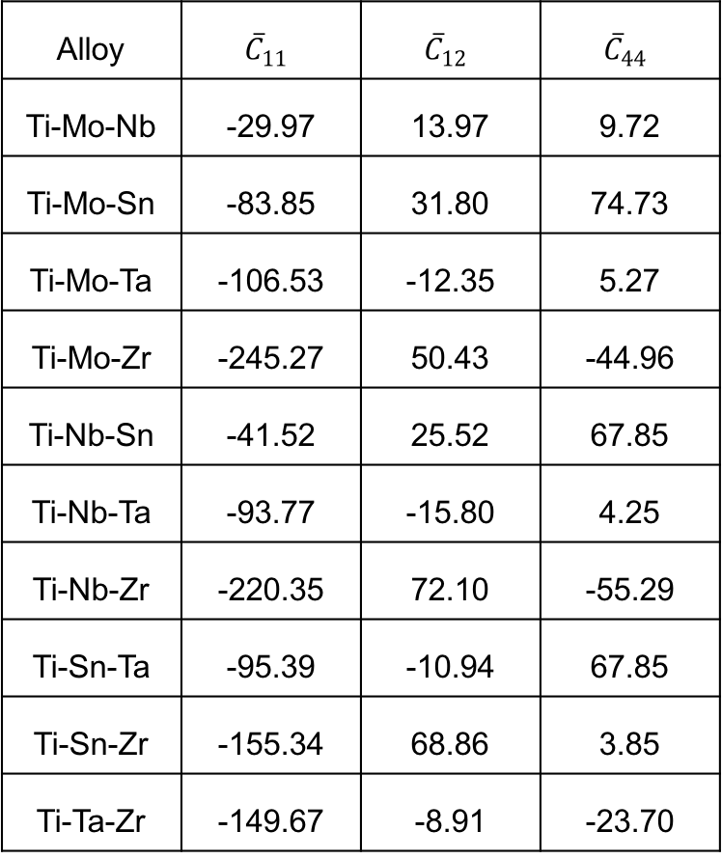
Elastic Modeling- Ti-X-Y C_{ij}
Alloy | $${\overline{C}}_{11}$$ | $${\overline{C}}_{12}$$ | $${\overline{C}}_{44}$$
Ti-Mo-Nb | -29.97 | 13.97 | 9.72
Ti-Mo-Sn | -83.85 | 31.80 | 74.73
Ti-Mo-Ta | -106.53 | -12.35 | 5.27
Ti-Mo-Zr | -245.27 | 50.43 | -44.96
Ti-Nb-Sn | -41.52 | 25.52 | 67.85
Ti-Nb-Ta | -93.77 | -15.80 | 4.25
Ti-Nb-Zr | -220.35 | 72.10 | -55.29
Ti-Sn-Ta | -95.39 | -10.94 | 67.85
Ti-Sn-Zr | -155.34 | 68.86 | 3.85
Ti-Ta-Zr | -149.67 | -8.91 | -23.70

Slide 20
Calculation of the Young’s modulus
H. Ikehata, N. Nagasako, T. Furuta, A. Fukumoto, K. Miwa, T. Saito, Phys. Rev. B. 70 (2004) 174113.; T. Ozaki, H. Matsumoto, S. Watanabe, S. Hanada, Mater. Trans. 45 (2004) 2776–2779.; R.R. Boyer, G. Welsch, E.W. Collings, ASM Int. Mater. Park. OH. (1994).; M.T. Mohammed, Z.A. Khan, A.N. Siddiquee, Int. J. Chem. Mol. Nucl. Mater. Metall. Eng. 8 (2014) 788–793.; F. Nozoe, H. Matsumoto, T.K. Jung, S. Watanabe, T. Saburi, S. Hanada, Mater. Trans. 48 (2007) 3007–3013.; M. Niinomi, M. Nakai, J. Hieda, Acta Biomater. 8 (2012) 3888–3903.

Slide 21
Ensuring Database Accuracy
Database Comparison
Binary interaction parameters- 0.69 to 14 GPa on average variance of 7 Gpa
Ternary interaction parameters-0.39 to 13 GPa on average variance of 5 GPa
M. Tane, S. Akita, T. Nakano, K. Hagihara, Y. Umakoshi, M. Niinomi, H. Mori, H. Nakajima, Acta Mater. 58 (2010) 6790–6798.; M.T. Mohammed, Z.A. Khan, A.N. Siddiquee, Int. J. Chem. Mol. Nucl. Mater. Metall. Eng. 8 (2014) 788–793.; M. Geetha, A.K. Singh, R. Asokamani, A.K. Gogia, Prog. Mater. Sci. 54 (2009) 397–425.

Slide 22
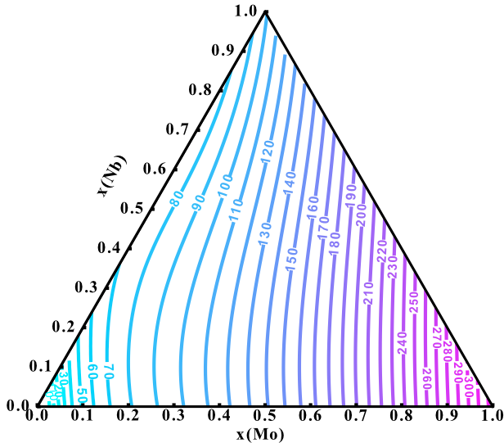
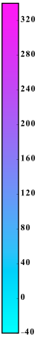
Young’s Modulus Mapping from the Database
R. Otis, Z.-K. Liu, J. Open Res. Softw. 5 (2017) 1–11.

Slide 23
Objectives
Study equilibrium phase stability
Establish a thermodynamic and elastic database for the Ti-Mo-Nb-Sn-Ta-Zr system
Study metastable phase stability
Study the elastic properties, phase stability and transformation of α” and ω phases

Slide 24
Metastable phase formation-effects E
Y. L. Zhou, M. Niinomi, and T. Akahori, Mater. Sci. Eng. A, vol. 371, no. 1–2, pp. 283–290, Apr. 2004.; Y.-L. Zhou and M. Niinomi, Mater. Sci. Eng. C, vol. 29, no. 3, pp. 1061–1065, Apr. 2009.; H. Ikehata, N. Nagasako, T. Furuta, A. Fukumoto, K. Miwa, and T. Saito, Phys. Rev. B, vol. 70, no. 17, p. 174113, 2004.; S. G. Fedotov, T. V. Chelidze, Y. K. Kovneristyy, and V. Sanadze, Phys. Met. Met., vol. 60, no. 3, pp. 139–143, 1985.; S. G. Fedotov and O. K. Belousov, Dokl. Akad. Nauk SSSR, vol. 150, no. 1, p. 77-, 1963.; C. Y. Wu, Y. H. Xin, X. F. Wang, and J. G. Lin, Solid State Sci., vol. 12, no. 12, pp. 2120–2124, Dec. 2010.; A. N. Timoshevskii, S. O. Yablonovskii, and O. M. Ivasishin, arXiv Prepr. arXiv1111.7182, 2011.; T. Ozaki, H. Matsumoto, S. Watanabe, and S. Hanada, Mater. Trans., vol. 45, no. 8, pp. 2776–2779, 2004.; M. Friák et al., Materials (Basel)., vol. 5, no. 10, pp. 1853–1872, 2012.; R. Karre, M. K. Niranjan, and S. R. Dey, Mater. Sci. Eng. C, vol. 50, pp. 52–58, May 2015.; H. Matsumoto, S. Watanabe, N. Masahashi, and S. Hanada, Metall. Mater. Trans. A, vol. 37, no. 11, pp. 3239–3249, 2006.

Slide 25
Ti-Nb Elastic Data
H.Y. Kim, Y. Ikehara, J.I. Kim, H. Hosoda, S. Miyazaki, Acta Mater. 54 (2006) 2419–2429.

Slide 26
Young’s Modulus predicted with phase fractions
All hcp < 10 at. % Nb
Predicted within 8 Gpa
10-30 at. % Nb mixture
bcc+alpha”
Predicted within 0.52 Gpa
hcp+bcc
Predicted within 22 Gpa
All bcc > 30 at. % Nb
Predicted within 7 GPa
A. N. Timoshevskii, S. O. Yablonovskii, and O. M. Ivasishin, arXiv Prepr. arXiv1111.7182, 2011.; T. Ozaki, H. Matsumoto, S. Watanabe, and S. Hanada, Mater. Trans., vol. 45, no. 8, pp. 2776–2779, 2004.; M. Friák et al., Materials (Basel)., vol. 5, no. 10, pp. 1853–1872, 2012.; R. Karre, M. K. Niranjan, and S. R. Dey, Mater. Sci. Eng. C, vol. 50, pp. 52–58, May 2015.; H. Matsumoto, S. Watanabe, N. Masahashi, and S. Hanada, Metall. Mater. Trans. A, vol. 37, no. 11, pp. 3239–3249, 2006.

Slide 27
Phase Stability at 0 K of Ti-Nb and Ti-Ta

Slide 28
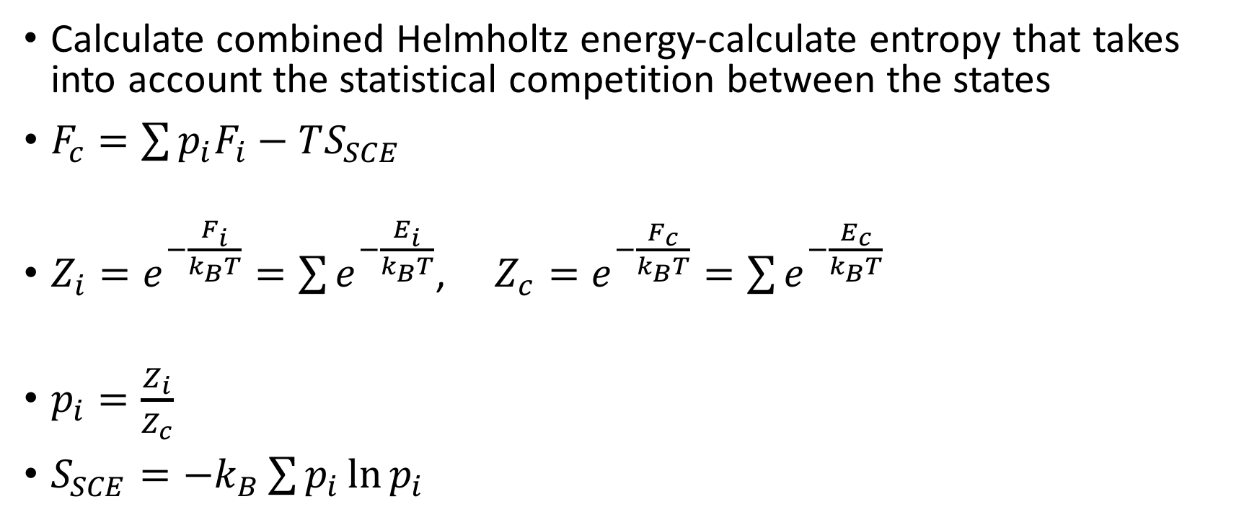
Partition Function Approach
Calculate combined Helmholtz energy-calculate entropy that takes into account the statistical competition between the states
$F_{c}=\sum{p_{i}F_{i}−TS_{SCE}}$
$Z_{i}=e^{−\frac{F_{i}}{k_{B}T}}=\sum{e^{−\frac{E_{i}}{k_{B}T}}}$, $Z_{c}=e^{−\frac{F_{c}}{k_{B}T}}=\sum{e^{−\frac{E_{c}}{k_{B}T}}}$
$p_{i}=\frac{Z_{i}}{Z_{c}}$
$S_{SCE}=−k_{B}\sum{p_{i}\ln{p_{i}}}$

Slide 29
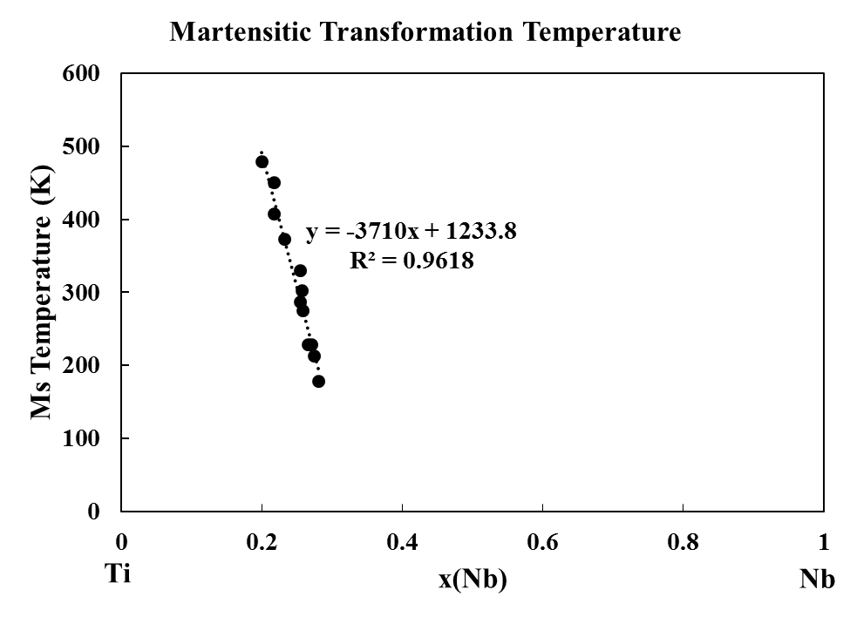
Ti-Nb Martensite
Practicing taking neutron ARCS data and converting it to DOS
4 compositions x(Nb)=0.1, 0.12, 0.18, 0.2
Two- 2 in by 2 in samples for each compostion
1 sample at each composition will be annealed and cold water quenched
Only studied at 300 K
1 sample will be annealed
Studied at 1110, 900 500, 300 K
y=0 at x=0.33
H.Y. Kim, Y. Ikehara, J.I. Kim, H. Hosoda, S. Miyazaki, Acta Mater. 54 (2006) 2419–2429.

Slide 31
Entropy difference between slow cooled and quenched samples
Phonon DOS show differences which concludes that they formed the different phases expected
Entropy difference between samples increases with increasing Nb
Further investigation is required to explain

Slide 32
Ti-Nb Diffraction Patterns and phase fractions
Alloy | x(Nb) | Phase Fraction
 |  | bcc | omega | Alpha”
Quenched | 0.10 | 0.12 | - | 0.88
 | 0.12 | 0.20 | - | 0.80
 | 0.18 | 0.57 | - | 0.43
 | 0.20 | 0.70 | - | 0.30
Slow Cooled | 0.10 | 0.20 | 0.80 | -
 | 0.12 | 0.30 | 0.70 | -
 | 0.18 | 0.60 | 0.40 | -
 | 0.20 | 0.70 | 0.30 | -
Alloy | x(Nb) | Phase Fraction
 |  | bcc | Alpha”
Friak | 0.10 | 0.06 | 0.94
 | 0.12 | 0.60 | 0.40
M. Friák et al., Materials (Basel)., vol. 5, no. 10, pp. 1853–1872, 2012.;

Slide 33
Summary
Established a thermodynamic database to predict the phase stabilities in the Ti-Mo-Nb-(Sn)-Ta-Zr system
Established a elastic database to predict the elastic properties of the BCC phase of the Ti-Mo-Nb-Sn-Ta-Zr system
Studied the elastic properties, phase stability and transformation of α” and ω phases

Slide 34
Future Work
Finish the thermodynamic modeling of the Sn binary and ternary systems
Introduce the hcp phase and interaction parameters for the non-Ti containing systems to the elastic database
Continue working on the theoretic framework for predicting the formation of metastable phases
Study the type of transformation taking place for the metastable phases by doing temperature dependent neutron scattering

Slide 35
Acknowledgements
Dr. Liu, Shunli and Dr. Zhao
Funding Sources
DOE- Science Graduate Research Award
NSF-NRT funding
NSF-Ti Grant 1333999
NSF Grant No. ACI-1053575
DOE Grant No. DE-AC02-05CH11231

Slide 36
Backup Slides

Slide 37
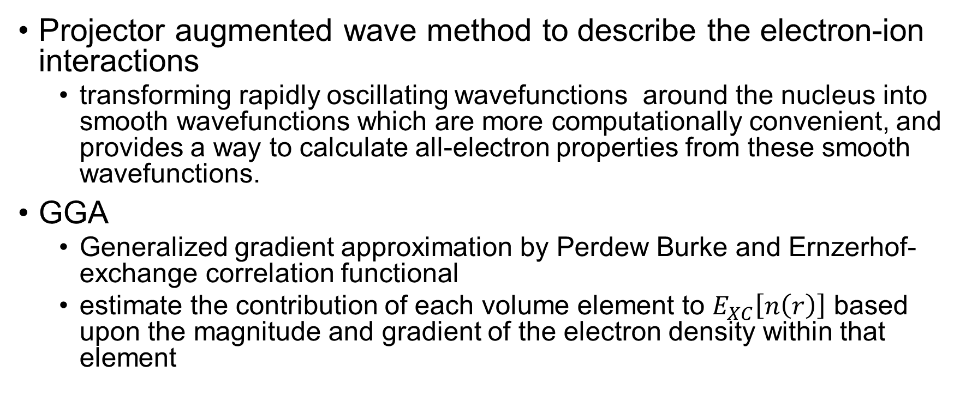
PAW
Projector augmented wave method to describe the electron-ion interactions
transforming rapidly oscillating wavefunctions around the nucleus into smooth wavefunctions which are more computationally convenient, and provides a way to calculate all-electron properties from these smooth wavefunctions.
GGA
Generalized gradient approximation by Perdew Burke and Ernzerhof-exchange correlation functional
estimate the contribution of each volume element to $E_{XC}\left[n\left(r\right)\right]$ based upon the magnitude and gradient of the electron density within that element
G. Kresse, D. Joubert, From ultrasoft pseudopotentials to the projector augmented-wave method, Phys. Rev. B. 59 (1999) 1758–1775.
J.P. Perdew, K. Burke, M. Ernzerhof, Phys. Rev. Lett. 77 (1996) 3865

Slide 38
PW91 vs PBE
PW91 is the first reasonable GGA that can be reliably used over a very wide range of materials.
PW91 contains much of the known correct physics of the exchange and correlation interactions.
PBE is based on PW91 containing the correct features of LDA but the correct (but hopefully not important!) features of PW91 that are ignored are:
Correct 2nd order gradient coefficients of ex and Ec in the slowly varying limit.
Correct non-uniform scaling of εx in the limits where s tend to infinity.
J.P. Perdew, K. Burke, M. Ernzerhof, Phys. Rev. Lett. 77 (1996) 3865

Slide 39
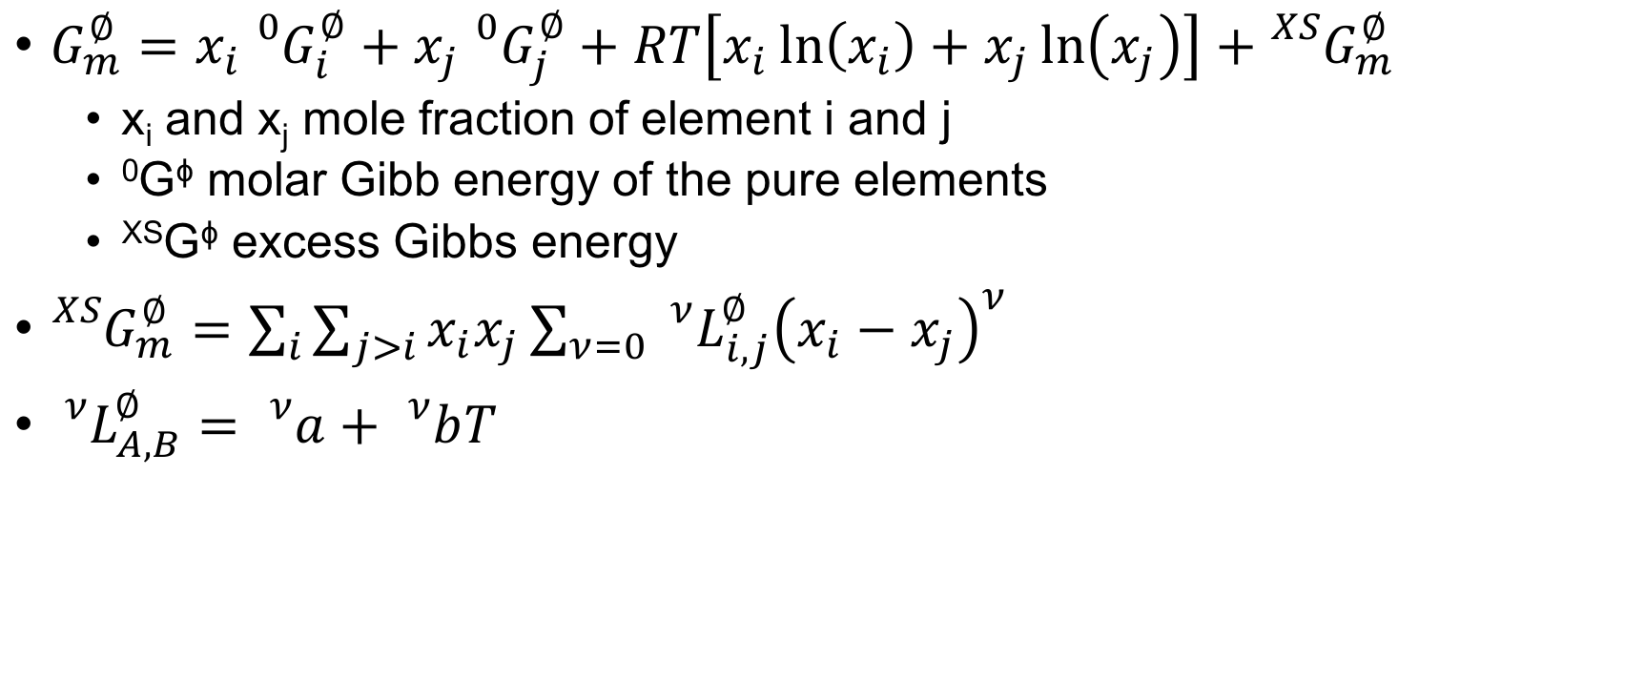
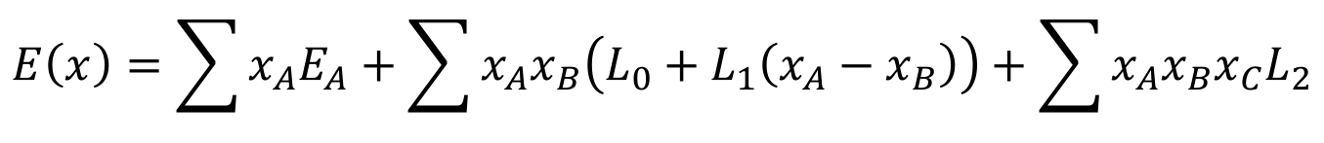
CALPHAD methodology binary solution phases
$G_{m}^{∅}=x_{i}{}_{}^{0}{G_{i}^{∅}+x_{j}{}_{}^{0}{G_{j}^{∅}+RT\left[x_{i}\ln\left(x_{i}\right)+x_{j}\ln\left(x_{j}\right)\right]+{}_{}^{XS}{G_{m}^{∅}}}}$
x_{i} and x_{j} mole fraction of element i and j
⁰G^{ϕ} molar Gibb energy of the pure elements
^{XS}G^{ϕ} excess Gibbs energy
${}_{}^{XS}{G_{m}^{∅}=\sum_{i}{\sum_{j>i}{x_{i}x_{j}}}\sum_{ν=0}{{}_{}^{ν}{L_{i,j}^{∅}{\left(x_{i}−x_{j}\right)}^{ν}}}}$
${}_{}^{ν}{L_{A,B}^{∅}}={}_{}^{ν}a+{}_{}^{ν}bT$
$$E\left(x\right)=\sum{x_{A}E_{A}}+\sum{x_{A}x_{B}\left(L_{0}+L_{1}\left(x_{A}−x_{B}\right)\right)}+\sum{x_{A}x_{B}x_{C}L_{2}}$$
Z.K. Liu, J. Phase Equilibria Diffus. 30 (2009) 517–534.

Slide 40
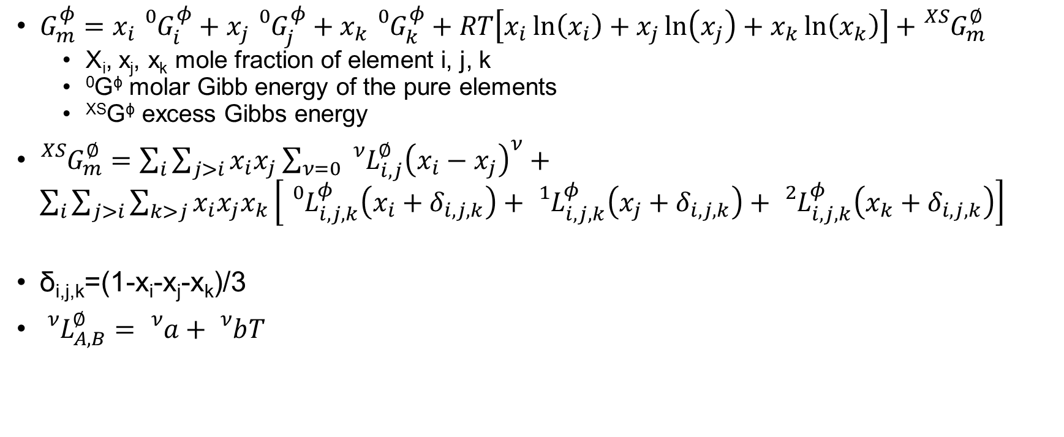
CALPHAD modeling ternary solution phases
$G_{m}^{φ}=x_{i}{}_{}^{0}{G_{i}^{φ}+x_{j}{}_{}^{0}{G_{j}^{φ}+x_{k}{}_{}^{0}{G_{k}^{φ}}+RT\left[x_{i}\ln\left(x_{i}\right)+x_{j}\ln\left(x_{j}\right)+x_{k}\ln\left(x_{k}\right)\right]+{}_{}^{XS}{G_{m}^{∅}}}}$
X_{i}, x_{j}, x_{k} mole fraction of element i, j, k
⁰G^{ϕ} molar Gibb energy of the pure elements
^{XS}G^{ϕ} excess Gibbs energy
${}_{}^{XS}{G_{m}^{∅}=\sum_{i}{\sum_{j>i}{x_{i}x_{j}}}\sum_{ν=0}{{}_{}^{ν}{L_{i,j}^{∅}{\left(x_{i}−x_{j}\right)}^{ν}}}}+\sum_{i}{\sum_{j>i}{\sum_{k>j}{x_{i}x_{j}x_{k}}}\left[{}_{}^{0}{L_{i,j,k}^{φ}\left(x_{i}+δ_{i,j,k}\right)+{}_{}^{1}{L_{i,j,k}^{φ}}\left(x_{j}+δ_{i,j,k}\right)+{}_{}^{2}{L_{i,j,k}^{φ}}\left(x_{k}+δ_{i,j,k}\right)}\right]}$
δ_{i,j,k}=(1-x_{i}-x_{j}-x_{k})/3
${}_{}^{ν}{L_{A,B}^{∅}}={}_{}^{ν}a+{}_{}^{ν}bT$
Z.K. Liu, J. Phase Equilibria Diffus. 30 (2009) 517–534.

Slide 41
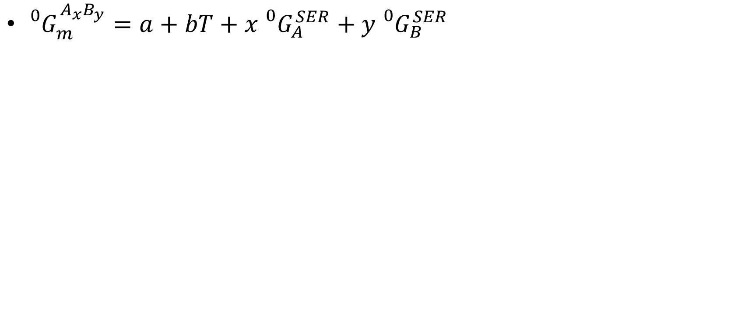
Calphad modeling stoichiometric compounds
${}_{}^{0}{G_{m}^{A_{x}B_{y}}=a+bT+x{}_{}^{0}{G_{A}^{SER}}+y{}_{}^{0}{G_{B}^{SER}}}$
Z.K. Liu, J. Phase Equilibria Diffus. 30 (2009) 517–534.

Slide 42
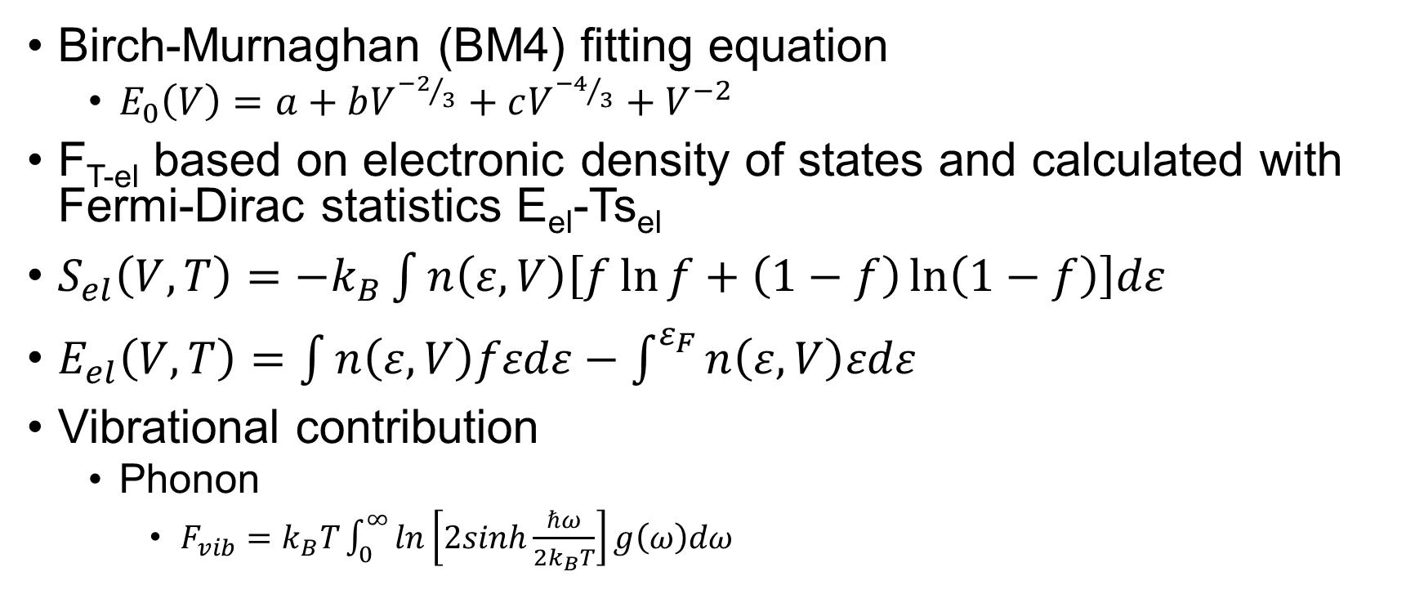
EOS Fitting, Debye Model, Phonon Model
Birch-Murnaghan (BM4) fitting equation
$E_{0}\left(V\right)=a+bV^{{−2}/3}+cV^{{−4}/3}+V^{−2}$
F_{T-el} based on electronic density of states and calculated with Fermi-Dirac statistics E_{el}-Ts_{el}
$S_{el}\left(V,T\right)=−k_{B}\int{n\left(ε,V\right)\left[f\ln{f}+\left(1−f\right)\ln\left(1−f\right)\right]dε}$
$E_{el}\left(V,T\right)=\int{n\left(ε,V\right)fεdε−\int^{ε_{F}}{n\left(ε,V\right)εdε}}$
Vibrational contribution
Phonon
$F_{vib}=k_{B}T\int_{0}^{∞}{ln\left[2sinh\frac{ℏω}{2k_{B}T}\right]g\left(ω\right)dω}$
Y. Wang, et al., Acta Mater. 52 (2004) 2665–2671.; S.L. Shang, et al. Comput. Mater. Sci. 47 (2010) 1040–1048.; A. Wang, et al., Calphad. 37 (2012) 126–131.

Slide 43
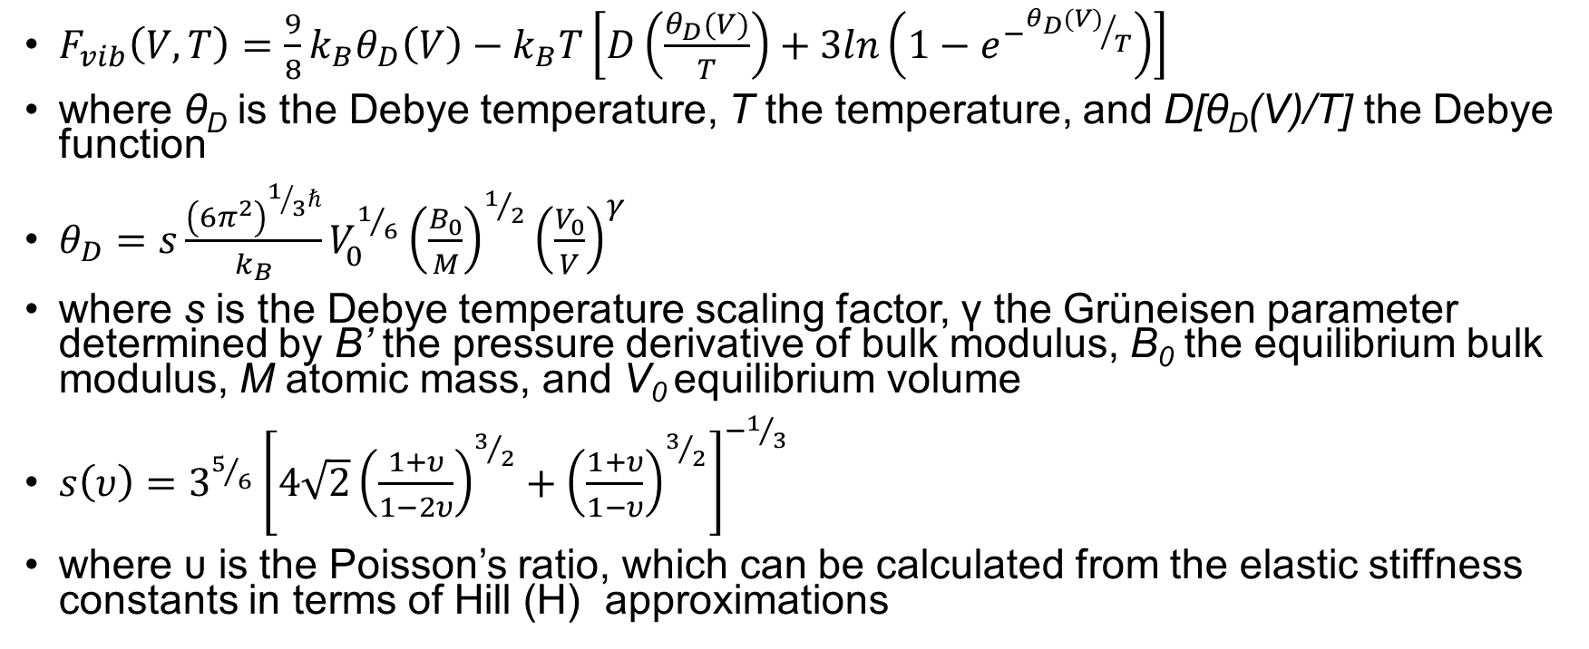
Debye Scaling Factor
$F_{vib}\left(V,T\right)=\frac{9}{8}k_{B}θ_{D}\left(V\right)−k_{B}T\left[D\left(\frac{θ_{D}(V)}{T}\right)+3ln\left(1−e^{−{θ_{D}(V)}/T}\right)\right]$
where θ_{D} is the Debye temperature, T the temperature, and D[θ_{D}(V)/T] the Debye function
$θ_{D}=s\frac{{\left(6π^{2}\right)}^{1/3ℏ}}{k_{B}}V_{0}^{1/6}{\left(\frac{B_{0}}{M}\right)}^{1/2}{\left(\frac{V_{0}}{V}\right)}^{γ}$
where s is the Debye temperature scaling factor, γ the Grüneisen parameter determined by B’ the pressure derivative of bulk modulus, B₀ the equilibrium bulk modulus, M atomic mass, and V₀ equilibrium volume
$s\left(υ\right)=3^{5/6}{\left[4\sqrt{2}{\left(\frac{1+υ}{1−2υ}\right)}^{3/2}+{\left(\frac{1+υ}{1−υ}\right)}^{3/2}\right]}^{−1/3}$
where υ is the Poisson’s ratio, which can be calculated from the elastic stiffness constants in terms of Hill (H) approximations
X.L. Liu et al., Comput. Mater. Sci. 98 (2015) 34–41.

Slide 44
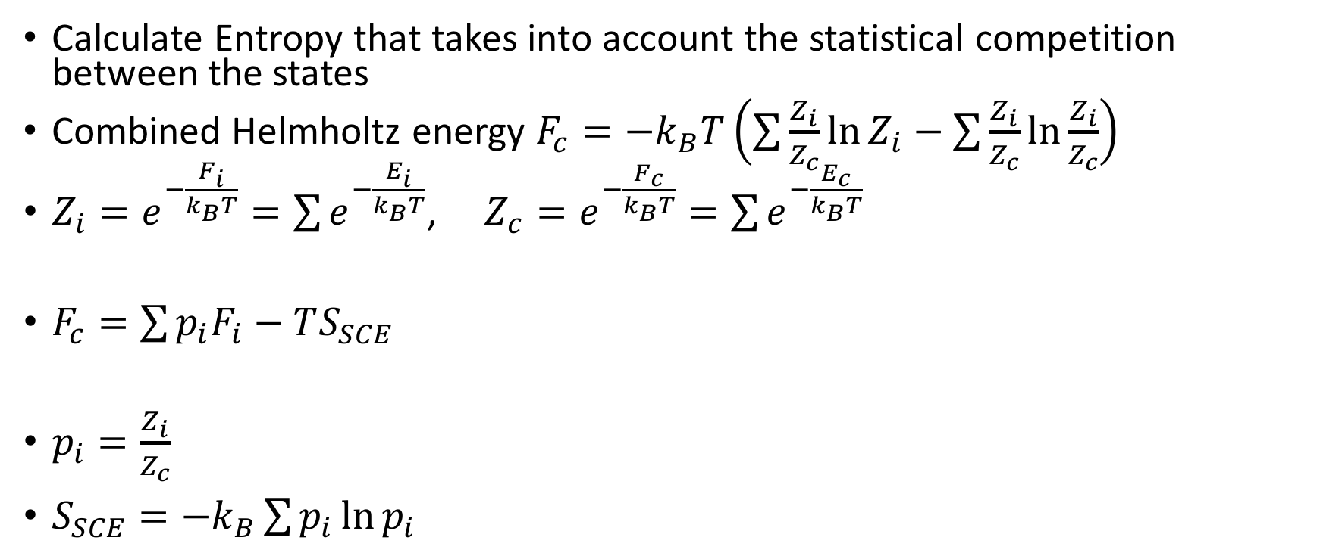
Partition Function Approach
Calculate Entropy that takes into account the statistical competition between the states
Combined Helmholtz energy $F_{c}=−k_{B}T\left(\sum{\frac{Z_{i}}{Z_{c}}\ln{Z_{i}}}−\sum{\frac{Z_{i}}{Z_{c}}\ln{\frac{Z_{i}}{Z_{c}}}}\right)$
$Z_{i}=e^{−\frac{F_{i}}{k_{B}T}}=\sum{e^{−\frac{E_{i}}{k_{B}T}}}$, $Z_{c}=e^{−\frac{F_{c}}{k_{B}T}}=\sum{e^{−\frac{E_{c}}{k_{B}T}}}$
$F_{c}=\sum{p_{i}F_{i}−TS_{SCE}}$
$p_{i}=\frac{Z_{i}}{Z_{c}}$
$S_{SCE}=−k_{B}\sum{p_{i}\ln{p_{i}}}$

Slide 45
Ti-Nb samples
x(Nb) 0.1, 0.12, 0.18, 0.2
Samples were made by arc melting
Cylindrical shapes 0.7 in diameter, 0.7 in thickness
Lindberg tube furnace to anneal at 1273 K 24 hours
Slow cooled and quenched

Slide 46
Neutron Scattering
ARCS- Angular-Range Chopper Spectrometer
Two incident neutron energies E=25meV and 50 meV at the 300 ,500, 700, 900, 1100 K temperatures
Vanadium sample holders-low coherent scattering for neutrons
Diffraction-elastic scattering, distance between scattering planes and modeled as a Gaussian function
phonon DOS using an iterative method to remove the elastic and multi-phonon contributions
Multi-phonon scattering event-is when multiple phonons are involved
Single phonon scattering event-phonon frequencies and eigenvectors
Coherent-depends on direction of q
Incoherent-scattering is uniform in all directions

Slide 47
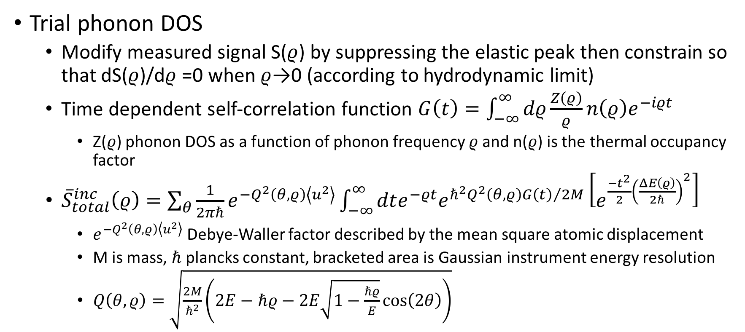
Phonon DOS
Trial phonon DOS
Modify measured signal S($ρ$) by suppressing the elastic peak then constrain so that dS($ρ$)/d$ρ$ =0 when $ρ$→0 (according to hydrodynamic limit)
Time dependent self-correlation function $G\left(t\right)=\int_{−∞}^{∞}{dρ\frac{Z\left(ρ\right)}{ρ}n\left(ρ\right)e^{−iρt}}$
Z($ρ$) phonon DOS as a function of phonon frequency $ρ$ and n($ρ$) is the thermal occupancy factor
${\overline{S}}_{total}^{inc}\left(ρ\right)=\sum_{θ}{\frac{1}{2πℏ}e^{−Q^{2}\left(θ,ρ\right)\left\langle u^{2}\right\rangle }}\int_{−∞}^{∞}{dte^{−ρt}e^{ℏ^{2}Q^{2}\left(θ,ρ\right){G\left(t\right)}/{2M}}\left[e^{\frac{−t^{2}}{2}{\left(\frac{ΔE\left(ρ\right)}{2ℏ}\right)}^{2}}\right]}$
$e^{−Q^{2}\left(θ,ρ\right)\left\langle u^{2}\right\rangle }$ Debye-Waller factor described by the mean square atomic displacement
M is mass, $ℏ$ plancks constant, bracketed area is Gaussian instrument energy resolution
$Q\left(θ,ρ\right)=\sqrt{\frac{2M}{ℏ^{2}}\left(2E−ℏρ−2E\sqrt{1−\frac{ℏρ}{E}}\cos\left(2θ\right)\right)}$

Slide 48
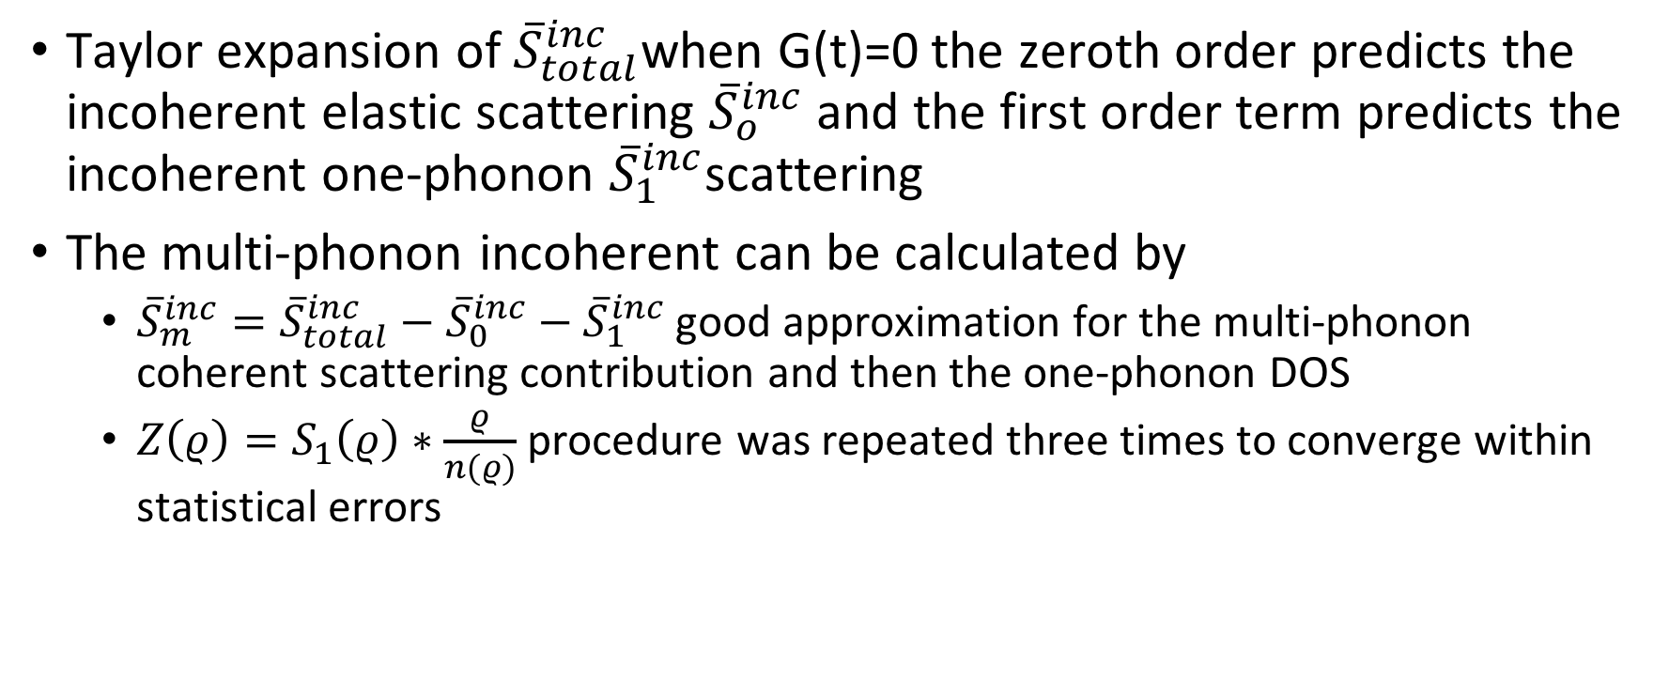
Phonon DOS
Taylor expansion of ${\overline{S}}_{total}^{inc}$when G(t)=0 the zeroth order predicts the incoherent elastic scattering ${\overline{S}}_{o}^{inc}$and the first order term predicts the incoherent one-phonon ${\overline{S}}_{1}^{inc}$scattering
The multi-phonon incoherent can be calculated by
${\overline{S}}_{m}^{inc}={\overline{S}}_{total}^{inc}−{\overline{S}}_{0}^{inc}−{\overline{S}}_{1}^{inc}$ good approximation for the multi-phonon coherent scattering contribution and then the one-phonon DOS
$Z\left(ρ\right)=S_{1}\left(ρ\right)∗\frac{ρ}{n(ρ)}$ procedure was repeated three times to converge within statistical errors

Slide 49
Ti-X Relaxation Calculations
Alloy | Length | Alloy | Length | Alloy | Length | Alloy | Length
Ti | 50 | Mo | 50 | 75Ti25Sn | 4x4x4 | 25Ti75Ta | 4x4x4
Ti15Mo | 80 | Ti53Nb | 4x4x4 | 50Ti50Sn | 80 | Ta | 50
Ti7Mo | 80 | Ti7Nb | 4x4x4 | 25Ti75Sn | 4x4x4 | Ti53Zr | 3x3x3
75Ti25Mo | 4x4x4 | 75Ti25Nb | 4x4x4 | Sn | 50 | 75Ti25Zr | 4x4x4
50Ti50Mo | 4x4x4 | 50Ti50Nb | 4x4x4 | Ti53Ta | 80 | 50Ti50Zr | 4x4x4
25Ti75Ti | 4x4x4 | 25Ti75Nb | 4x4x4 | Ti7Ta | 80 | 25Ti75Zr | 4x4x4
Mo15Ti | 80 | Nb | 50 | 75Ti25Ta | 5x5x5 | Zr15Ti | 80
Mo53Ti | 50 | Ti15Sn | 80 | 50Ti50Ta | 4x4x4 | Zr | 50
Gamma centered Monkhorst-Pack grids; NSW=50, ENCUT 310, High Precision, SQS are 16-atom
Notes:
$N_{1}=max\left(1,l∗\left|\vec{b_{1}}\right|+0.5\right)$--either specify length with the 10 large gap insulators and 100 d-metals, AxAxA where the subdivisions of N_1, N_2, N_3 along reciprocal lattice vectors

Slide 50
Ti-X-Y Relaxation Calculations
3 ternary SQS calculations
TiXY- 12-Ti, 12-X, 12-Y
Ti2XY- 16-Ti, 8-X, 8-Y
Ti6XY- 48-Ti, 8-X, 8-Y
KPOINTS were gamma centered M-P 4x4x4
X0.5Y0.5 16 atom cell
KPOINTS were gamma centered M-P 80
Encut 310
High Precision
Sigma 0.2
NSW 50

Slide 51
Thermodynamic Modeling-Binary Systems
W. Xiong, Y. Du, Y. Liu, B.Y. Huang, H.H. Xu, H.L. Chen, Z. Pan, Calphad-Computer Coupling Phase Diagrams Thermochem. 28 (2004) 133–140 .

Slide 52
Thermodynamic Modeling-Binary Systems
R.J. Perez, B. Sundman, Calphad-Computer Coupling Phase Diagrams Thermochem. 27 (2003) 253–262.; J.P. Abriata, J.C. Bolcich, Bull. Alloy Phase Diagrams. 3 (1982) 34–44.; A.F. Guillermet,, J. Alloys Compd. 226 (1995) 174–184.

Slide 53
Thermodynamic Modeling-Ti-Mo
I. Ansara, A.T. Dinsdale, M.H. Rand,, European Communities, Brussels and Luxembourg, 1998.; J.L. Murray, Bull. Alloy Phase Diagrams. 2 (1981) 185–192.; T. Uesugi, S. Miyamae, K. Higashi, Mater. Trans. 54 (2013) 484–492.

Slide 54
Thermodynamic Modeling-Ti-Ta
J.L. Murray, ASM Int. (1987) 354.; I. Ansara, A.T. Dinsdale, M.H. Rand, European Communities, Brussels and Luxembourg, 1998.

Slide 55
Thermodynamic Modeling-Ti-Zr
K.C.H. Kumar, P. Wollants, L. Delaey, J. Alloys Compd. 206 (1994) 121–127

Slide 56
Thermodynamic Modeling-Ti-Mo-Nb
o-phase boundary
•-single-phase
◑-two-phase
873 K
L. Na, W.H. Warnes, Ieee Trans. Appl. Supercond. 11 (2001) 3800–3803.

Slide 57
Thermodynamic Modeling-Ti-Mo-Nb
o-phase boundary
•-single-phase
◑-two-phase
873 K
D.A. Prokoshkin, M.I. Zakharova, in: Akad. Nauk SSSR, Dokl., 1967: pp. 1382–1384.; J.J. English, DTIC Document, 1961.

Slide 58
Thermodynamic Modeling-Ti-Mo-Ta
o-phase boundary
•-single-phase
◑-two-phase
Phase | Parameters | Value
BCC_A2 (Ti,Mo,Ta) |  | -15731.2
873 K
a
b
P.N. Nikitin, V.S. Mikheyev, Russ. Metall. (1971) 144–147

Slide 59
Thermodynamic Modeling-Ti-Mo-Zr
o-phase boundary
•-single-phase
◑-two-phase
S. Kar, D.M. Lipkin, in: TMS 2008 Annu. Meet. Suppl. Proceedings, Vol 2 Mater. Charact. Comput. Model., Minerals, Metals & Materials Soc, Warrendale, 2008: pp. 237–243.; D.A. Prokoshkin, M.I. Zakharova, in: Akad. Nauk SSSR, Dokl., 1967: pp. 1382–1384

Slide 60
Thermodynamic Modeling-Ti-Nb-Zr
o-phase boundary
•-single-phase
◑-two-phase
1273 K
1773 K
L. Lin, L. Delaey, O. VanDerBiest, P. Wollants, Scr. Mater. 34 (1996) 1411–1416.; M. Hoch, D.B. Butrymow, Trans. Metall. Soc. AIME. 230 (1964) 186–192

Slide 61
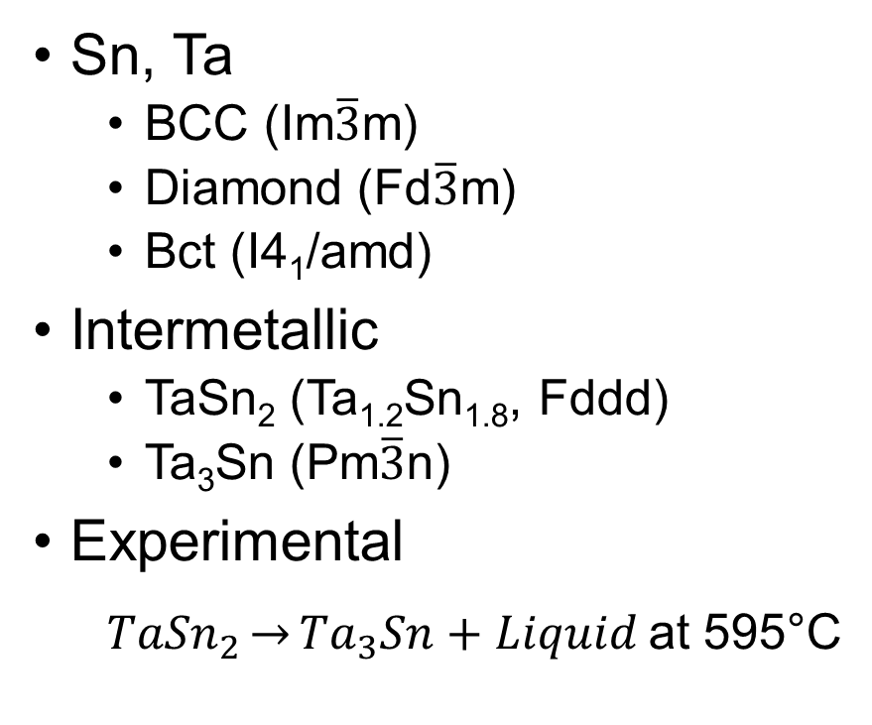
Sn-Ta System
Sn, Ta
BCC (Im$\overline{3}$m)
Diamond (Fd$\overline{3}$m)
Bct (I4₁/amd)
Intermetallic
TaSn₂ (Ta_{1.2}Sn_{1.8}, Fddd)
Ta₃Sn (Pm$\overline{3}$n)
Experimental
${TaSn}_{2}\underset{→}{}{Ta}_{3}Sn+Liquid$at 595°C
H. Okamoto, Sn-Ta (Tin-Tantalum), J. Phase Equilibria. 24 (2003) 484.
Notes:
Monkhorst pack shceme and an energy cutoff of 300 ev 54

Slide 62
Sn-Ta Calculation Details
Element | Calculation | Unit Cell Size | Encut (eV) | KPOINTS subdivision
Beta-Sn | EOS/Debye 0.617 | 4 atoms | 80 | 320
 | Phonon | 48 atoms | 80 | 320
Diamond-Sn | EOS/Debye | 8 atoms | 150 | 150
 | Phonon | 32 atoms | 4x4x4 | 300
Bcc-Ta | EOS/Debye 0.617 | 54 atoms | 6x6x6 | 313
 | Phonon | 54 atoms | 5x5x5 | 313
Bcc-Sn | EOS/Debye | 54 atoms | 6x6x6 | 337
Ta₃Sn | EOS/Debye 0.389 | 8 atoms | 50 | 300
 | Elastic | 8 atoms | 80 | 300
 | Phonon | 64 atoms | 80 | 300
TaSn₂ | EOS/Debye 0.789 | 12 atoms | 10x10x5 | 300
 | Elastic | 12 atoms | 4x4x4 | 300
 | Phonon | 96 atoms | 80 | 300
SQS | EOS | 16 atoms | 80 | 300
$N_{1}=max\left(1,l∗\left|\vec{b_{1}}\right|+0.5\right)$ N₂, l, b₂ N₃, l, b₃
$$\vec{k}=\vec{b_{1}}\frac{n_{1}}{N_{1}}+\vec{b_{2}}\frac{n_{2}}{N_{2}}+\vec{b_{3}}\frac{n_{3}}{N_{3}}$$

Slide 63
Scaling Factor
 | TaSn₂ |  | Ta₃Sn
 | Present work | FP [43,44,46,47] | Present work 8 atoms | Present work 32 atoms | FP [44–47]
C₁₁ (GPa) | 166 | 161 | 297 | 310 | 226
C₁₂ (GPa) | 79 | 78 | 127 | 131 | 155
C₁₃ (GPa) | 62 | 57
C₂₂ (GPa) | 189 | 182
C₂₃ (GPa) | 68 | 68
C₃₃ (GPa) | 187 | 183
C₄₄(GPa) | 37 | 35 | 65 | 68 | 22
C₅₅ (GPa) | 59 | 55
C₆₆ (GPa) | 61 | 60
Young’s Modulus (GPa) | 135 |  | 210 | 202
Shear Modulus (GPa) | 53 | 51 | 80 | 76 | 27
Poisson Ratio | 0.288 | 0.29 | 0.32 | 0.32 | 0.43
Scaling factor | 0.789 |  | 0.71 | 0.71
B_{cij} (GPa) | 107 | 107 | 184 | 190 | 179
B_{EOS} (GPa) | 104 |  | 182

Slide 64
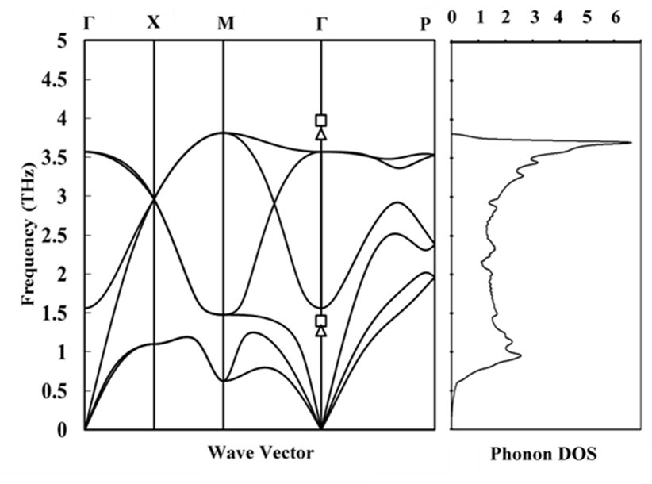
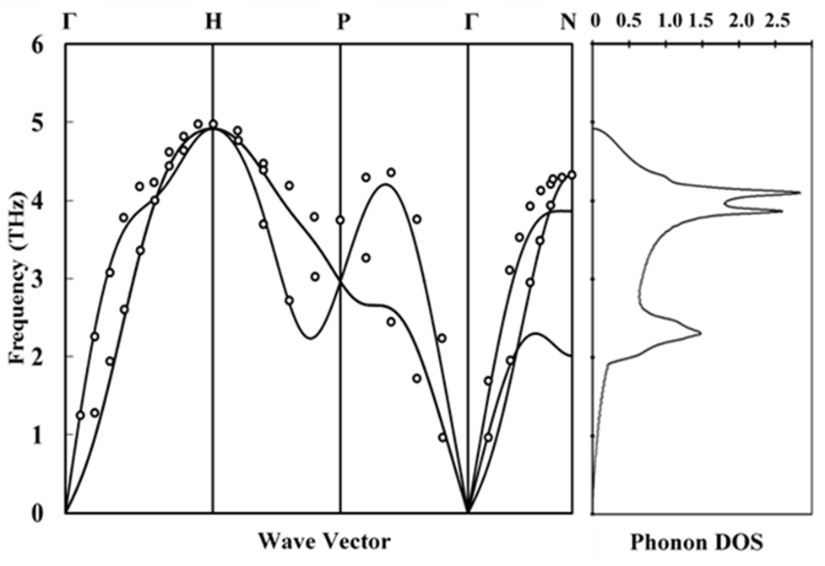
Dispersion Curves Sn and Ta
Calculated phonon dispersion curve of bct-Sn is on the left. The squares (□) are the LO and TO modes found from neutron scattering at 110 K. The triangles (∆) are the LO and TO modes found from Raman at ambient pressures [1].
Calculated phonon dispersion curve of bcc-Ta, was compared with neutron diffraction experiments (○) [2]. The values for phonon DOS have no meanings, the same for other figures.
H. Olijnyk, Phys. Rev. B. (1992).; S. Taioli et al., Phys. Rev. B. 75 (2007) 214103.

Slide 65
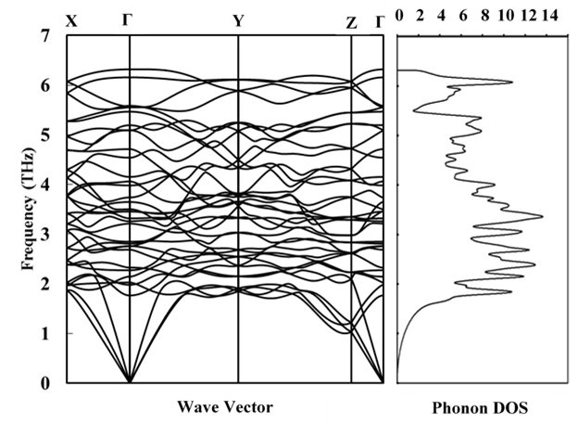
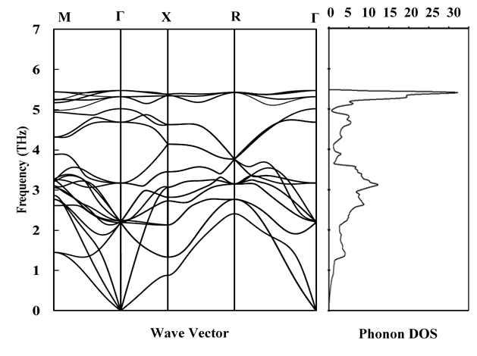
Dispersion Curves TaSn₂ and Ta₃Sn
Calculated phonon dispersion curve for TaSn₂ at 0 K.
Calculated phonon dispersion curve of Ta3Sn is calculated on the left at 0 K.

Slide 66
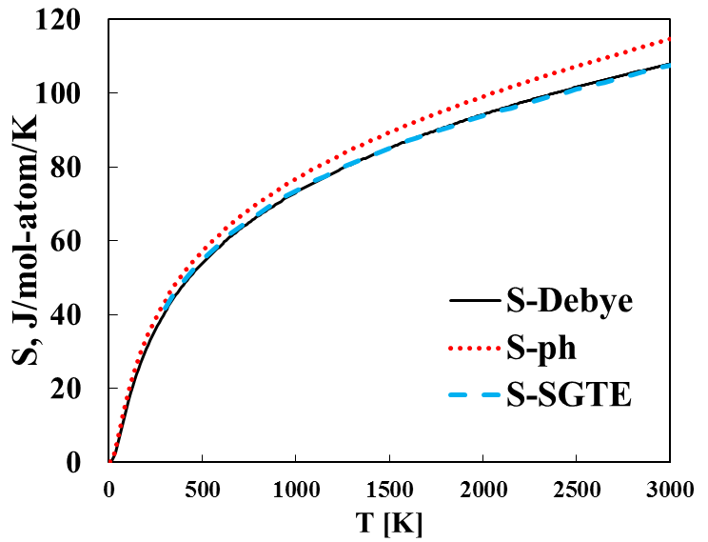
bcc-Ta Results
Lattice parameter (Å) | V (Å³/atom) | B (GPa) | Reference
3.316 3.328 3.330 | 18.241 | 193.7 | This work EOS (0 K) Phonon (298 K) Debye (298 K)
3.30 | 17.969 | 200 | Expt. [1]
3.32 | 18.313 | 195.3 | DFT [2]
[1] R. Predmore et al., Scr. Metall. 4 (1970) 213–217. [2] S.L. Shang et al., Comput. Mater. Sci. 48 (2010) 813–826.

Slide 67
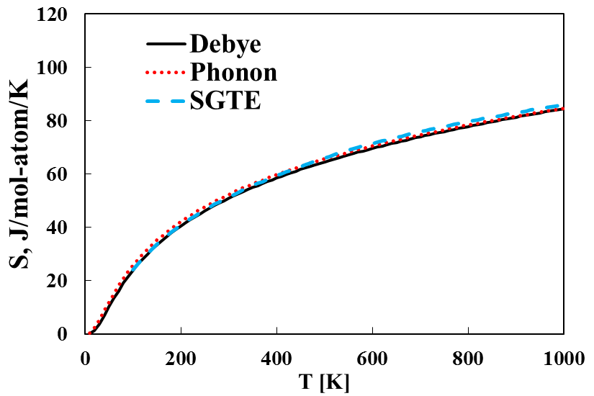
bct-Sn Results
Lattice parameter (Å) |  | V (Å³/atom) | B (GPa) | Reference
a | c
5.939 5.994 5.954 | 3.214 3.244 3.222 | 28.431 | 47.7 | This Work EOS (0K) Phonon (298 K) Debye (298 K)
5.83 | 3.18 | 27.055 | 58.0 | Expt. [1-2]
5.93 | 3.23 | 28.396 | 54.0 | DFT [2-3]
[1] W.P. Allen et al., Metall. Trans. A. 22 (1991) 753–764. [2] E. Peltzer et al., Phys. Rev. B. 48 (1993) 15712–15718. [3] R. Arróyave et al., Phys. Rev. B. (2006).

Slide 68
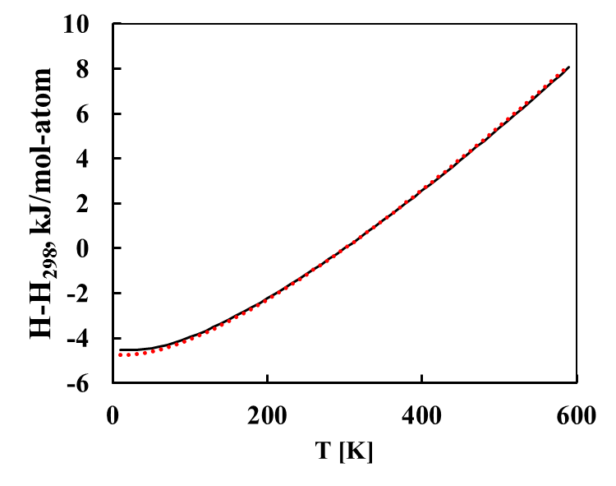
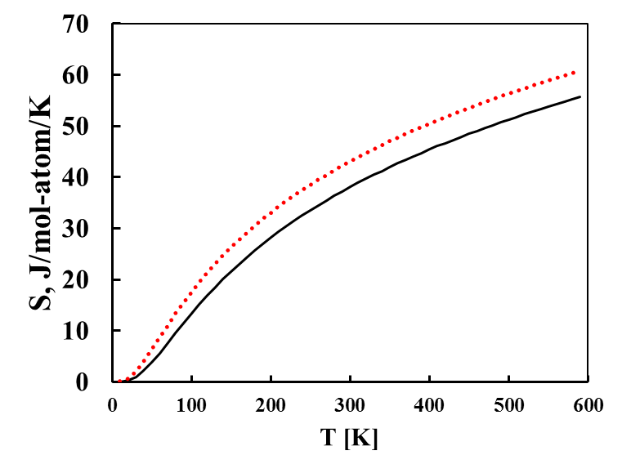
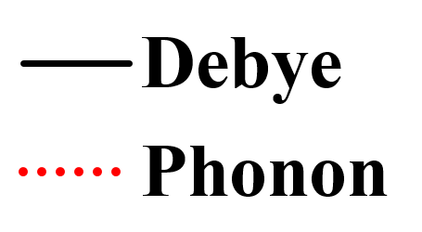
TaSn₂ Results
Lattice parameter (Å) |  |  | V (Å³/atom) | B (GPa) | Reference
a | b | c
5.641 5.695 5.652 | 9.766 9.854 9.785 | 19.200 19.386 19.238 | 22.631 | 104.3 | This work EOS (0 K) Phonon (298 K) Debye (298 K)
5.63 | 9.80 | 19.18 |  |  | Expt [1]
L. Calvert, P. Villars, ASM, Mater. Park. OH. (1991).

Slide 69
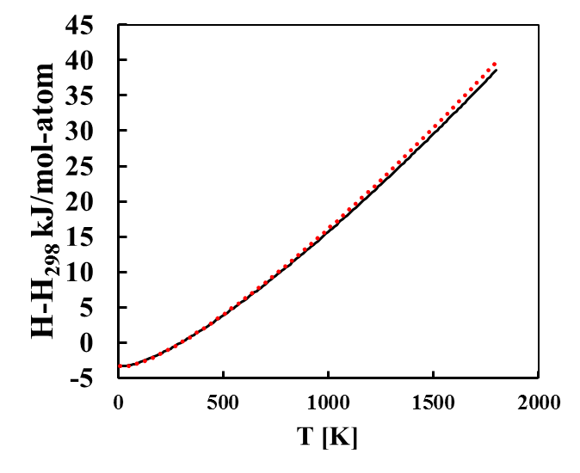
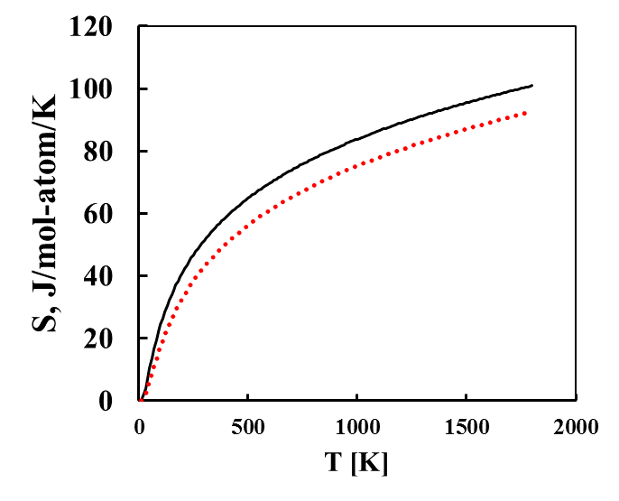
Ta₃Sn Results
Lattice parameter (Å) | V (Å³/atom) | B (GPa) | Reference
5.304 5.319 5.319 | 18.668 | 182.4 | This work EOS (0 K) Phonon (298 K) Deybe (298 K)
5.29 |  |  | Expt [1]
T.H. Courtney et al., J. Appl. Phys. 36 (1965) 3256–3260.

Slide 70
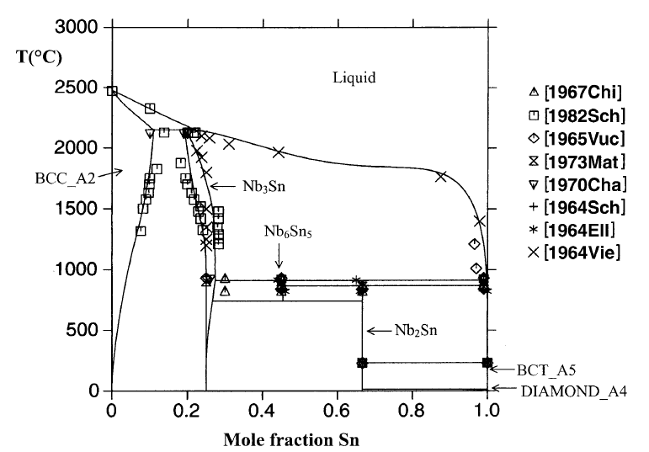
Phase Diagram
Nb
Sn
C. Toffolon et al., J. Phase Equilibria. 23 (2002) 134–139.

Slide 71
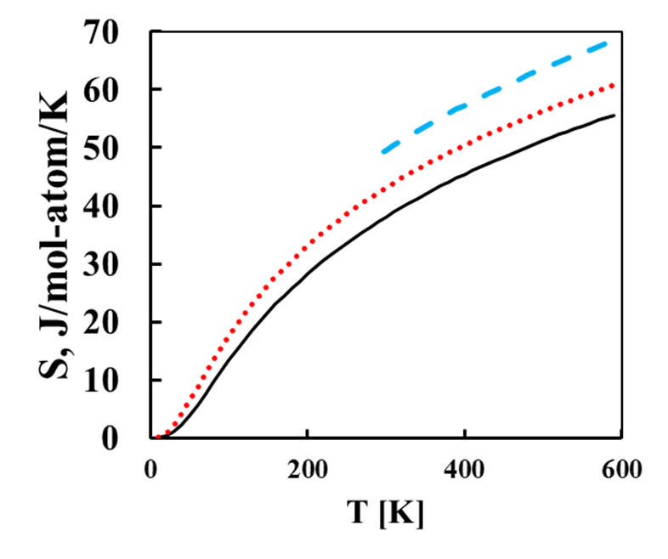
TaSn₂ Results

Slide 72

Ta₃Sn Results

Slide 73
Phase (model) | Modeled Parameters
bcc_A2 (Sn,Ta) | $${}_{}^{0}{L_{Ta,Sn}^{bcc}=70451}$$
 | $${}_{}^{1}{L_{Ta,Sn}^{bcc}=112237}$$
Liquid (Sn,Ta) | $${}_{}^{0}{L_{Ta,Sn}^{Liq}=−17118}$$
TaSn₂ | $$G^{Ta{Sn}_{2}}=2{}_{}^{0}{G_{Sn}^{bct}+{}_{}^{0}{G_{Ta}^{bcc}}−29678−4.202T}$$
Ta₃Sn | $$G^{{Ta}_{3}Sn}={}_{}^{0}{G_{Sn}^{bct}+3{}_{}^{0}{G_{Ta}^{bcc}}−68844−6.000T}$$

Slide 74

Liquid Enthalpy of Mixing
C. Toffolon et al., J. Phase Equilibria. 23 (2002) 134–139.

Slide 75

Elastic Theory
A set of strains (ε₁, ε₂, ε₃, ε₄, ε₅, ε₆) ε₁, ε₂, ε₃ are normal strains and ε₄, ε₅, ε₆ are shear strains
$L_{def}=L\left(\begin{matrix}1+ε_{1} & {ε_{6}}/2 & {ε_{5}}/2 \\ {ε_{6}}/2 & 1+ε_{2} & {ε_{4}}/2 \\ {ε_{5}}/2 & {ε_{4}}/2 & 1+ε_{3}\end{matrix}\right)$
Generate a set of stresses use hooks law
Apply linearly independent set of strains to the supercell
$\left(\begin{matrix}x & 0 & 0 & 0 & 0 & 0 \\ 0 & x & 0 & 0 & 0 & 0 \\ 0 & 0 & x & 0 & 0 & 0 \\ 0 & 0 & 0 & x & 0 & 0 \\ 0 & 0 & 0 & 0 & x & 0 \\ 0 & 0 & 0 & 0 & 0 & x\end{matrix}\right)$
S.L. Shang et al., Appl. Phys. Lett. 90 (2007) 101909.

Slide 76

Voigt-Reuss-Hill
${\overline{C}}_{11}=\frac{\left(c_{11}+c_{22}+c_{33}\right)}{3}$, ${\overline{C}}_{12}=\frac{\left(c_{12}+c_{13}+c_{23}\right)}{3}$, ${\overline{C}}_{44}=\frac{\left(c_{44}+c_{55}+c_{66}\right)}{3}$
$B_{V}={\left({\overline{C}}_{11}+2{\overline{C}}_{12}\right)}/3$, $B_{R}=1/{\left(3{\overline{S}}_{11}+6{\overline{S}}_{12}\right)}$
$G_{V}={\left({\overline{C}}_{11}−{\overline{C}}_{12}+3{\overline{C}}_{44}\right)}/5$, $G_{R}=5/{\left(4{\overline{S}}_{11}+6{\overline{S}}_{12}\right)}$
$E_{V}={\left(9B_{V}G_{V}\right)}/{\left(3B_{V}+G_{V}\right)}$, $E_{R}={\left(9B_{R}G_{R}\right)}/{\left(3B_{R}+G_{R}\right)}$
$B_{H}={\left(B_{V}+B_{R}\right)}/2$, $G_{H}={\left(G_{V}+G_{R}\right)}/2$
$E_{H}={\left(9B_{H}G_{H}\right)}/{\left(3B_{H}+G_{H}\right)}$
Stability
$c_{11}−\left|c_{12}\right|>0$
$c_{11}+2c_{12}>0$
$c_{44}>0$

Slide 77
X-C Functional Comparison
a
b
c
d

Slide 78
Strain Rate Comparison
a
b
c
d

Slide 79
Ti-X C₁₁

Slide 80
Ti-X-Y C₁₁

Slide 81
Ti-X-Y C₁₁

Slide 82
Ti-X C₁₂

Slide 83
Ti-X-Y C₁₂

Slide 84
Ti-X-Y C₁₂

Slide 85
Ti-X C₄₄

Slide 86
Ti-X-Y C₄₄

Slide 87
Ti-X-Y C₄₄

Slide 88
C₁₁-C₁₂

Slide 89
Ti-X E

Slide 90
Ti-X-Y E

Slide 91
Ti-X-Y E

Slide 92
Ti-X B

Slide 93
Ti-X-Y B

Slide 94
Ti-X-Y B

Slide 95
Ti-X G

Slide 96
Ti-X-Y G

Slide 97
Ti-X-Y G

Slide 98










Slide 100

$α$”

Slide 101

$$ω$$

Slide 102
hcp

